Slide 1
Sharlene World Simulation Model Documentation
ADMIT ONE

Slide 2
Model Description
Simulation Objective:
To simulate a theme park environment, including different types of rides and how they might impact visitor experiences and the profits of the park.
Type of model used in the simulation:
The model uses agent-based modelling, which means that individual agents are created to represent the visitors to the park. These agents are programmed with different behaviors and preferences, which influence how they interact with the park and its rides.
Output analysis:
Data collected from the simulation is used to perform output analysis, which involves analyzing the statistics and results generated by the simulation using various statistical analysis methods. This analysis could include measures of agent satisfaction level and ride popularity.

Slide 3
Overview of Code
Main function
Map Class
Array of Agent Objects
Array of MapNode objects
Shortest Path Algorithm
Map Node Object
Update Agents in MapNode
Agent Object
Update Agent States
Update next MapNode Object to travel to
Export to CSV
Calculate Statistics
User Interface
Averages
Graph Display
Data for output Analysis

Slide 4
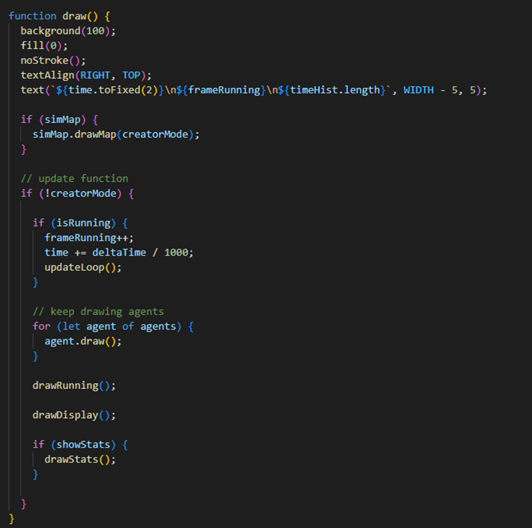
Final Coding
Main Loop for rides and agents

Slide 5
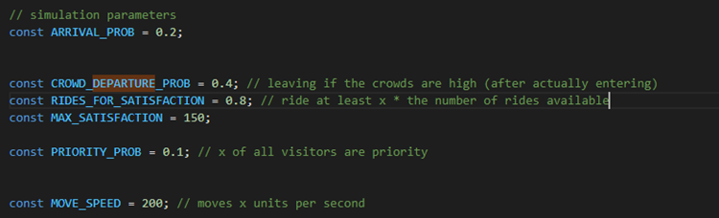
Final Coding
Simulation parameters

Slide 6
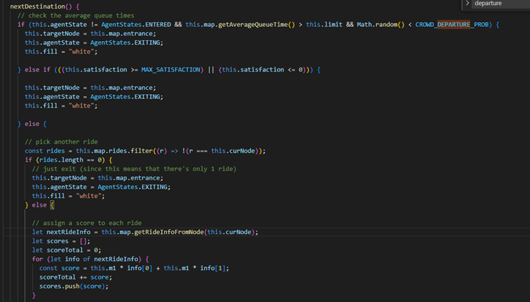
Final Coding
Agent next destination code, using queue and distance weights to choose next destination

Slide 7
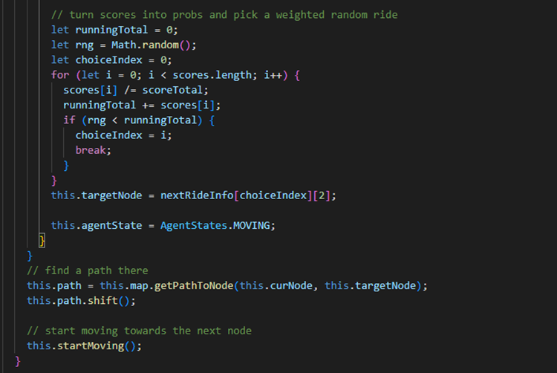
Final Coding
Agent next destination code, using queue and distance weights to choose next destination

Slide 8
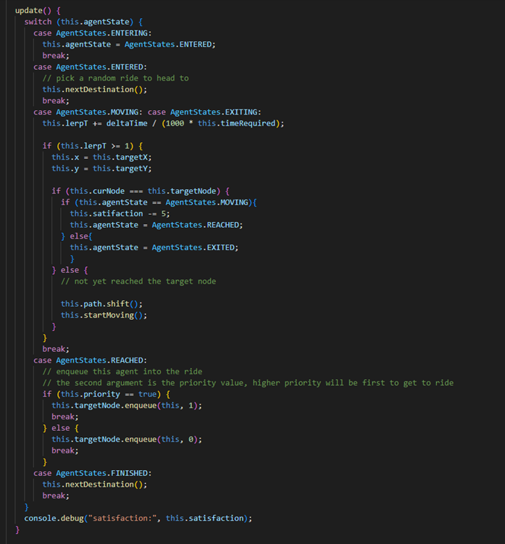
Final Coding
Agent state update loop

Slide 9
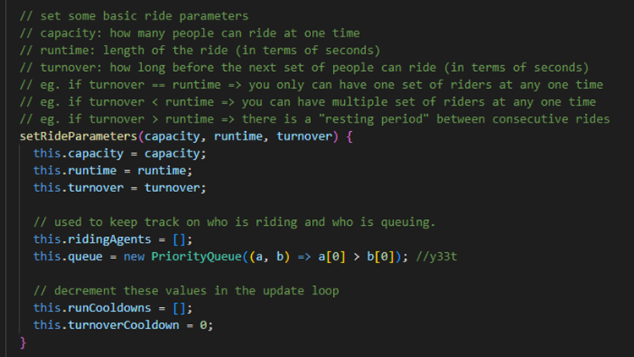
Final Coding
Ride parameters

Slide 10
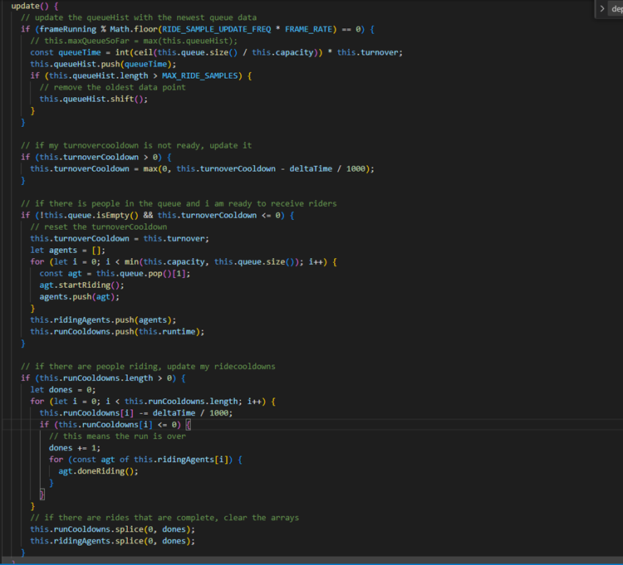
Final Coding
Ride update loop

Slide 11
Requirements
The simulation is divided into three main components:
Agents:
- Agents with the express pass are colored blue, while agents with the standard pass are labelled green. When the agents are exiting the ride, they are colored white.
Agent Attributes:
Satisfaction score: A numerical score that aims to simulate the “satisfaction level” of the agents when they are in the theme park. A higher score means a higher satisfaction, and the satisfaction level of the agents starts from 100. When the agents are queuing or moving to their next destination, their satisfaction score will decrease. When they finish their rides, their satisfaction score will increase.
Priority: There are 2 types of passes in this theme park: standard pass vs express pass. If the agent purchased the express pass, the agent would have priority over the standard pass. However, the cost of the express pass is more than the cost of the standard pass.
Current location: The location of the ride the agent is currently at.

Slide 12
Requirements
Next location: The location of the ride/exit the agent is going to next.
Agent State: The current state of the agents. (Refer to state diagram)
Profits: The profits earned from each agent after each ride, calculated using (ticket cost – operation cost). The data for this was found in the background data.
Agent Behavior:
The agents will move from the entrance to their desired ride by calculating the shortest path to the ride and walking over. This calculation will take into consideration the agent’s tolerance for queues and walking distance to decide whether the agent wants to queue/ride in that specific ride.

Slide 13
Requirements
2. Rides:
- When the ride is in the process of riding, no new agents will be accepted into the ride. Once the ride is done and it is ready to accept new riders, they will accept riders up till the maximum capacity of the ride before starting the ride again.
Ride Attributes:
Ride locations: The x and y coordinates of the ride in the park
Type of Ride: The type of ride A, B or C. Each type of ride has different parameters.
Ride Parameters:
Ride Capacity: The maximum capacity of the ride
Ride Turnover: The time taken for the ride to get ready
Ride Duration: The time taken for the ride to end

Slide 14
Requirements
3. Theme Park
Collection of all the ride locations
Collection of all the agents
Collection of all the paths to the rides
Notes:
Due to single inheritance limit in JavaScript, we created a Map class that takes in the rides as nodes.
The rides themselves are a separate class known as Map Node, which helps to set the ride parameters and the entrance etc.
The visitors are objects that will interact with the rides under the Agent class.
To allow the agent to interact with the rides, we have a main function that contains the map (which contains the map nodes) and the agents.

Slide 15
First Draft Plan
Goal: Create a small version of simulation based on Proposal
Duration: Week 6 – 8
Designers: Xin Yi, Jie Lin, Danny, Robin
Developers: Danny, Robin

Slide 16
First Draft Description
The group aimed to create a scaled-down version of the theme park simulation.
The simulation was designed so that agents chose their next rides randomly, rather than based on specific preferences or behaviors.
We limited the number of agents to just one in order to test whether the logic of the simulation worked properly.
The simulation was also limited to just two types of rides, rather than including the full range of rides that might be present in a real theme park.
Rides were programmed to accept agents as long as their capacity was not full, rather than waiting to fill up a full batch of riders before starting the ride.

Slide 17
First Draft Description
The simulation included a basic interface that displayed graphs showing averages of various metrics, such as ride popularity and visitor satisfaction.
The interface also allowed for live statistics to be displayed for each individual ride, such as the current number of riders and the average wait time, which could be viewed by hovering the mouse over the specific ride.

Slide 18
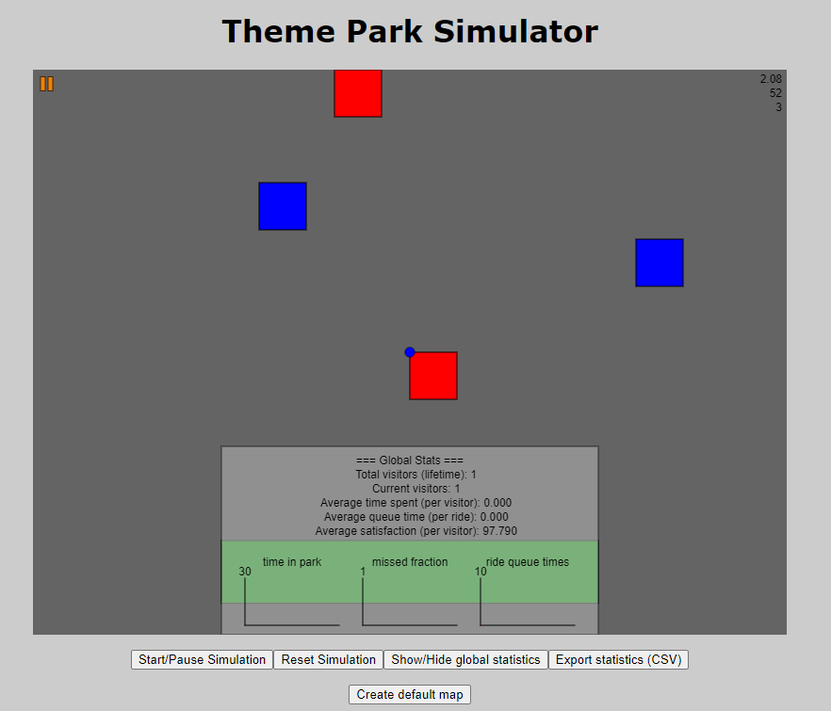
Represent Ride A
Represent Ride B
Agent (Visitor)
Graph & Statistic
Different navigation function button

Slide 19
First Draft Problems
After testing with 1 agent, we tried adding more agents and removing the rectangles as it was blocking some agents for now.
We found issues getting the shortest path algorithm to work correctly.
Agents were going beyond the shortest paths.
After fixing the issue with the shortest paths, we realized there was an issue where some agents stopped moving prematurely.
This was because of flaws in the update loop in the code, leading to the linear interpolation of the agents to be wrong.

Slide 20
First Draft Problems
In this first simulation, we did not calculate the profits, and there were some errors in the linear interpolation of the shortest path as some of the agents stopped moving prematurely. However, out of the agents that moved properly, we could test that the simulation logic was valid.

Slide 21
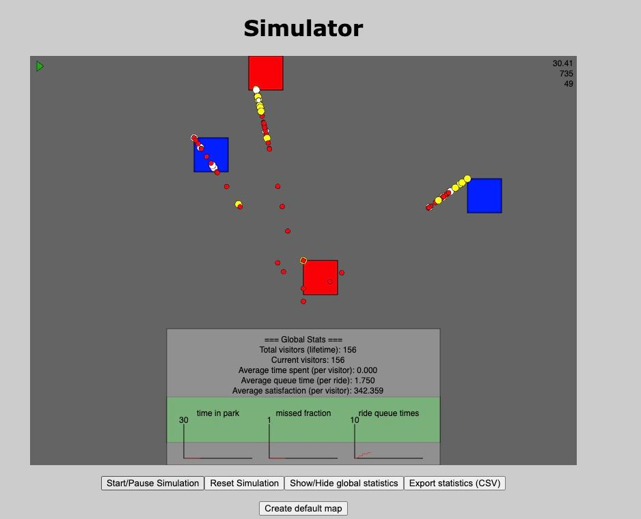
Adding more agents
Despite us using shortest paths, the agents stopping prematurely

Slide 22
Final Simulation Plan
Goal: Create the final simulation
Duration: Week 9 - 12
Designers: Xin Yi, Jie Lin, Danny, Robin
Developers: Danny, Robin

Slide 23
Final Simulation Description
The group focused on refining the final version of the theme park simulation, addressing issues such as agents stopping prematurely or walking out of the path.
Rides were modified so that they operated by batch rather than a continuous process, which made for a more realistic simulation as compared to the first draft.
Paths were drawn in the simulation to make it easier for users to visualize the movement of agents throughout the park.

Slide 24
Final Simulation Limitation
Due to time constraints, the group was unable to implement a creator mode for the simulation, which would have allowed users to customize various aspects of the park and its rides.

Slide 25
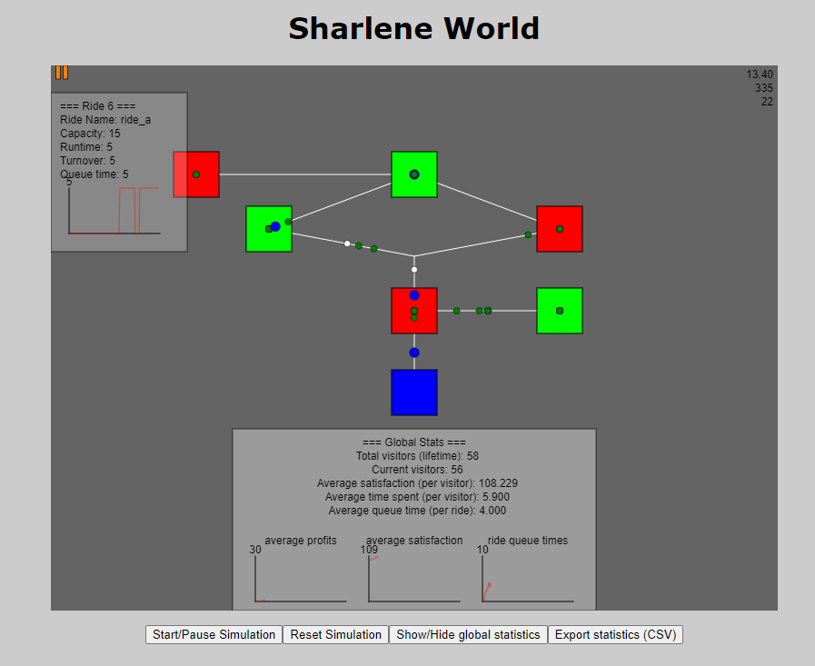
Scenario 1: Offer 2 different type of rides (A&B)
Ride A (Performance)
Ride B (Slow Train)
Statistics for individual ride when hover over the ride
Entrance of the theme park
Graphs & Statistics
Buttons to Control Simulation

Slide 26
Green Agent: Standard Pass (lower priority level compared to express pass)
White Agent: Exiting the ride
(when agent exit the ride, it will turn white)
Blue Agent: Express Pass
(higher priority level compared to standard pass)

Slide 27
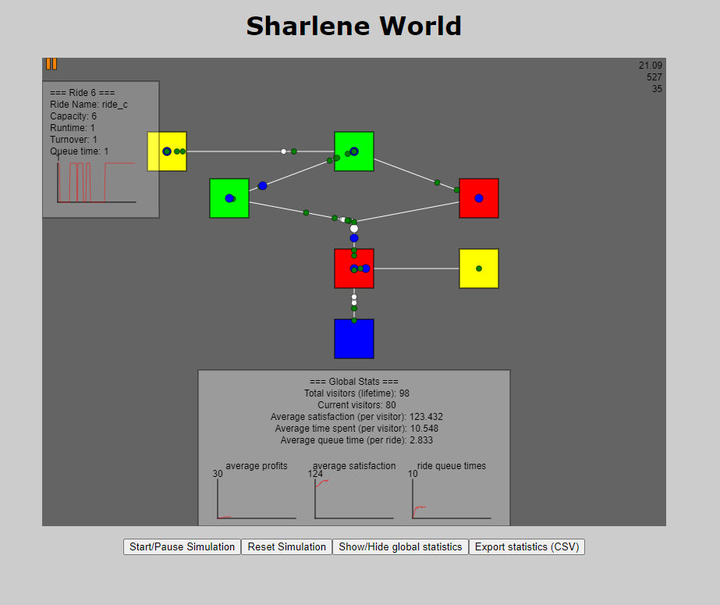
Average profit per visitor
Average satisfaction per visitor
Average ride queue time per ride (averaging all the type of ride)
Start/Pause simulation
Reset simulation
Show/Hide the graph & statistic
Export Statistic into CSV format

Slide 28
Ride number
Ride type
Maximum number of agents can be on the ride at a time
Queue Time
(can hover every individual ride in the simulation to see the queue time )

Slide 29
Scenario 2: Offer 3 different type of rides (A,B,C)
Ride A (Performance)
Ride B (Slow Train)
Ride C (Spinning type)
Statistics for individual ride when hover over the ride
Entrance of the theme park
Graphs & Statistics
Buttons to Control Simulation

Slide 30
Code Sources
https://www.w3schools.com/js/js_class_inheritance.asp
https://p5js.org/reference/
https://github.com/mickey1356/sim_project
https://stackoverflow.com/questions/42919469/efficient-way-to-implement-priority-queue-in-javascript
https://en.wikipedia.org/wiki/Floyd%E2%80%93Warshall_algorithm
Dijkstra’s Algorithm – Taken from SUTD Algorithms Notes

